Slide 1

PARTICIPANTS ABDULLAH AHMED ABDUL AHAD RIDA MALIK SUFIAN FARHAN SADIA AAMIR
We are empowering young minds to become agents of change for a sustainable future.

Slide 2
Sustainable Development Goals (SDGs) IN THE CLASSROOM
TEAM NAME: SPACE TITANS

Slide 3
We are excited to announce the launch of our new website, designed for individuals and youth to register and access free courses on sustainable development and related topics. Our platform empowers young learners to gain valuable knowledge and skills that can drive positive change in their communities.
In addition, we have created an engaging board game based on the 17 Sustainable Development Goals (SDGs). This interactive game motivates youth to learn about global challenges while having fun, and encouraging teamwork and creativity. Through these initiatives, we aim to inspire the next generation to become proactive agents of change for a sustainable future. Join us today and start your journey toward learning and making a difference!

Slide 4

Sustainable Development Goals (SDGs) into Science Education

Slide 5
17 SDGs
Introduction to No Poverty
Understanding Zero Hunger
Good Health and Well-being: Principles and Practices
Quality Education: Strategies and Solutions
Gender Equality: Concepts and Implementation
Clean Water and Sanitation: Challenges and Innovations
Affordable and Clean Energy: Technology and Policy
Decent Work and Economic Growth: Theories and Trends
Industry, Innovation, and Infrastructure: Development and Impact
Reducing Inequality: Policies and Practices
Sustainable Cities and Communities: Planning and Development
Responsible Consumption and Production: Sustainable Practices
Climate Action: Mitigation and Adaptation
Life Below Water: Conservation and Management
Life on Land: Biodiversity and Ecosystem Management
Peace, Justice, and Strong Institutions: Governance and Reform
Partnerships for the Goals: Collaboration and Strategy

Slide 6
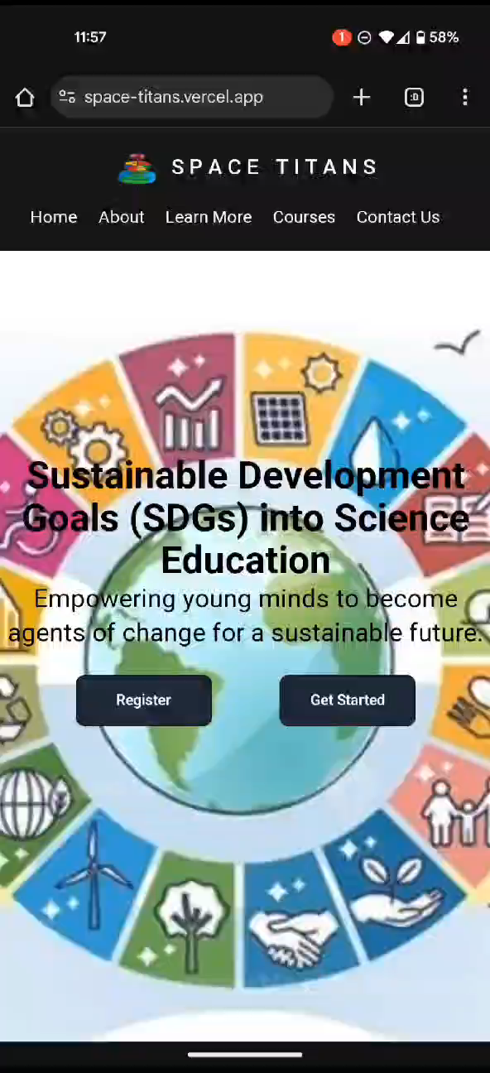
WEBSITE GLIMPSE

Slide 7
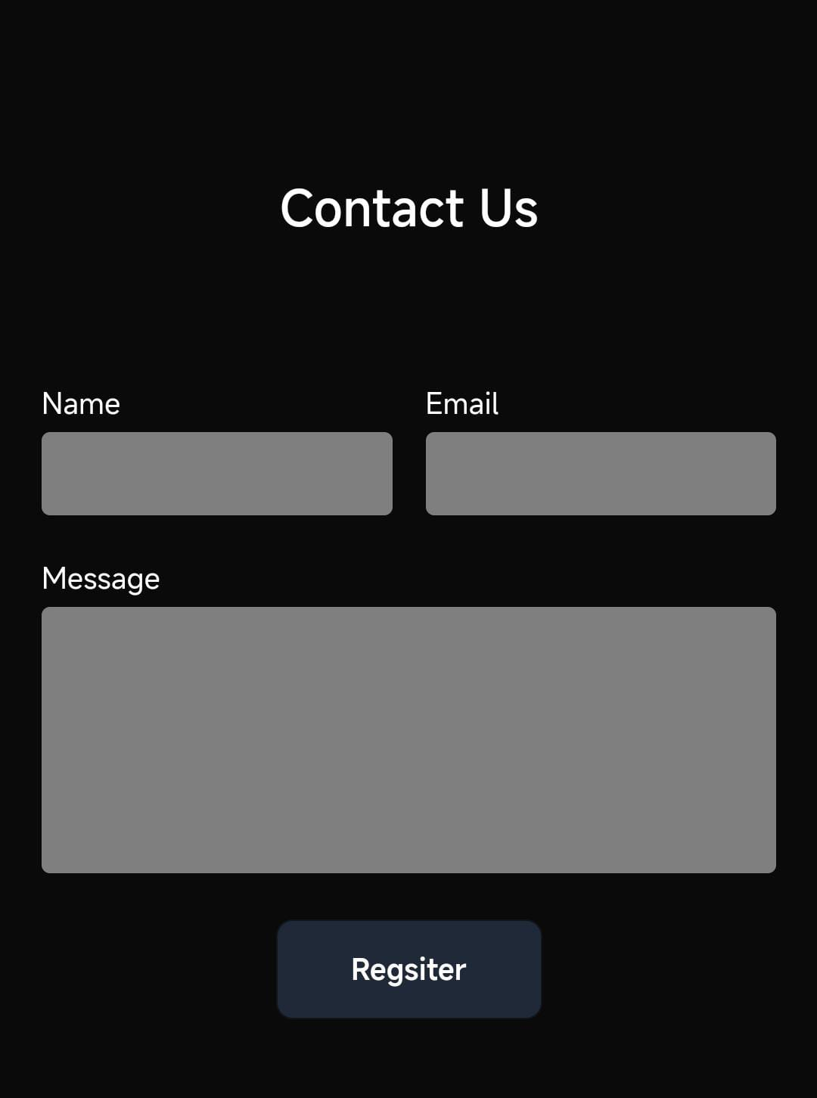
REGISTER
https://forms.gle/KcXRDpXEJPnwwAw46

Slide 8
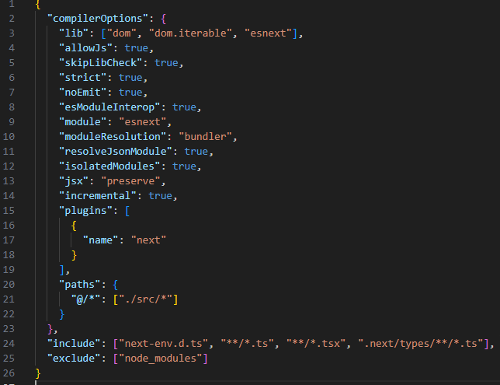
JAVASCRIPT
SOFTWARE: Coding-based website

Slide 9

Board Game

